Slide 1


Recommender System – Amazon reviews
Yuanyue Liu
Faculté de génie | Faculty of Engineering
uOttawa.ca

Slide 2
Agenda
2
Introduction
Collaborative filtering
Data processing
Building systems
Performance Analysis and improvement

Slide 3
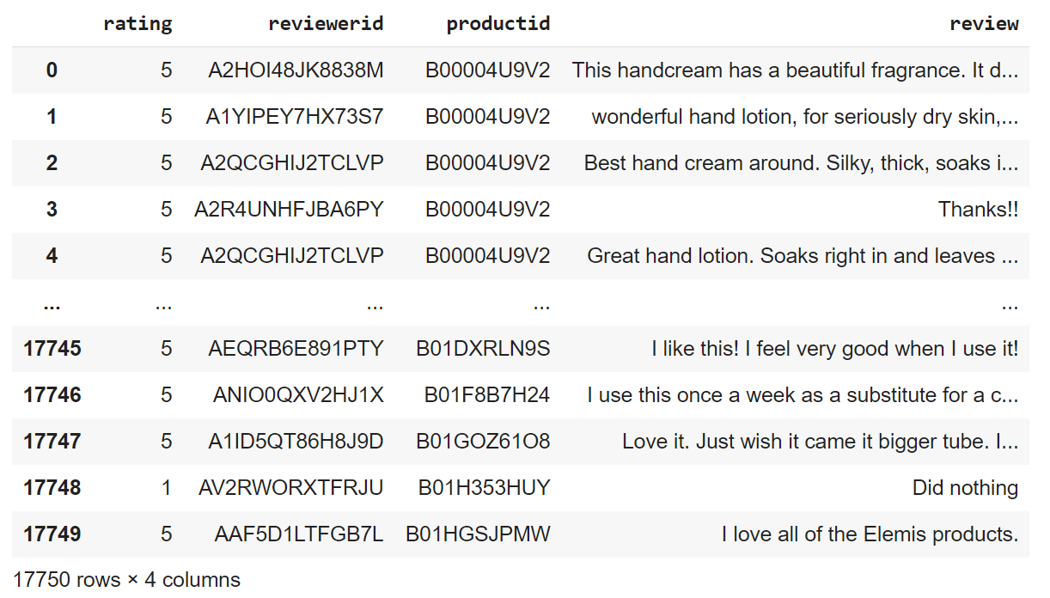
Data source
Amazon product reviews from https://jmcauley.ucsd.edu /data/amazon/.
Luxury beauty category, covering years 1996-2018.
Information on product ID, reviewer ID, text of the review, and rating of the product.
Notes:
To be noted that

Slide 4
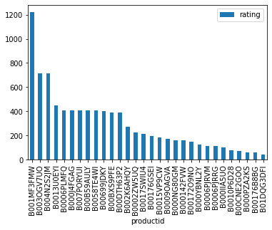
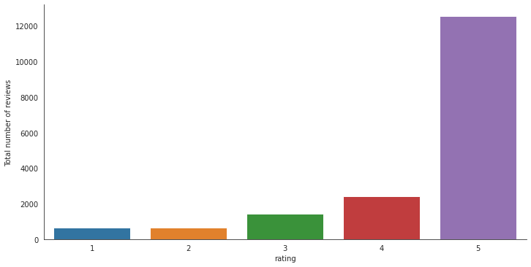
Exploratory analysis
Popularity based on the number of reviews
Distribution of ratings
Notes:
To be noted that

Slide 5
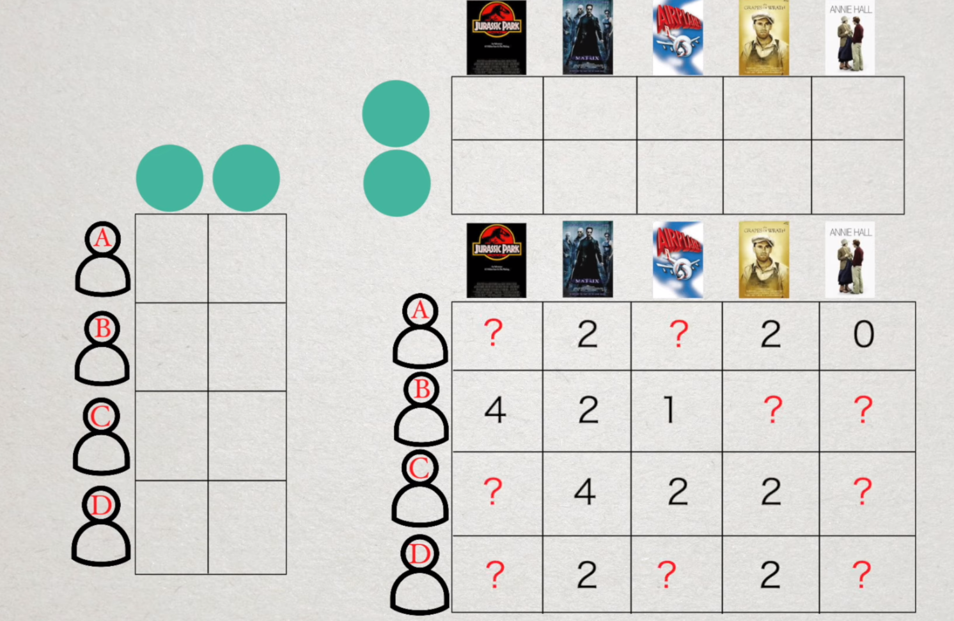
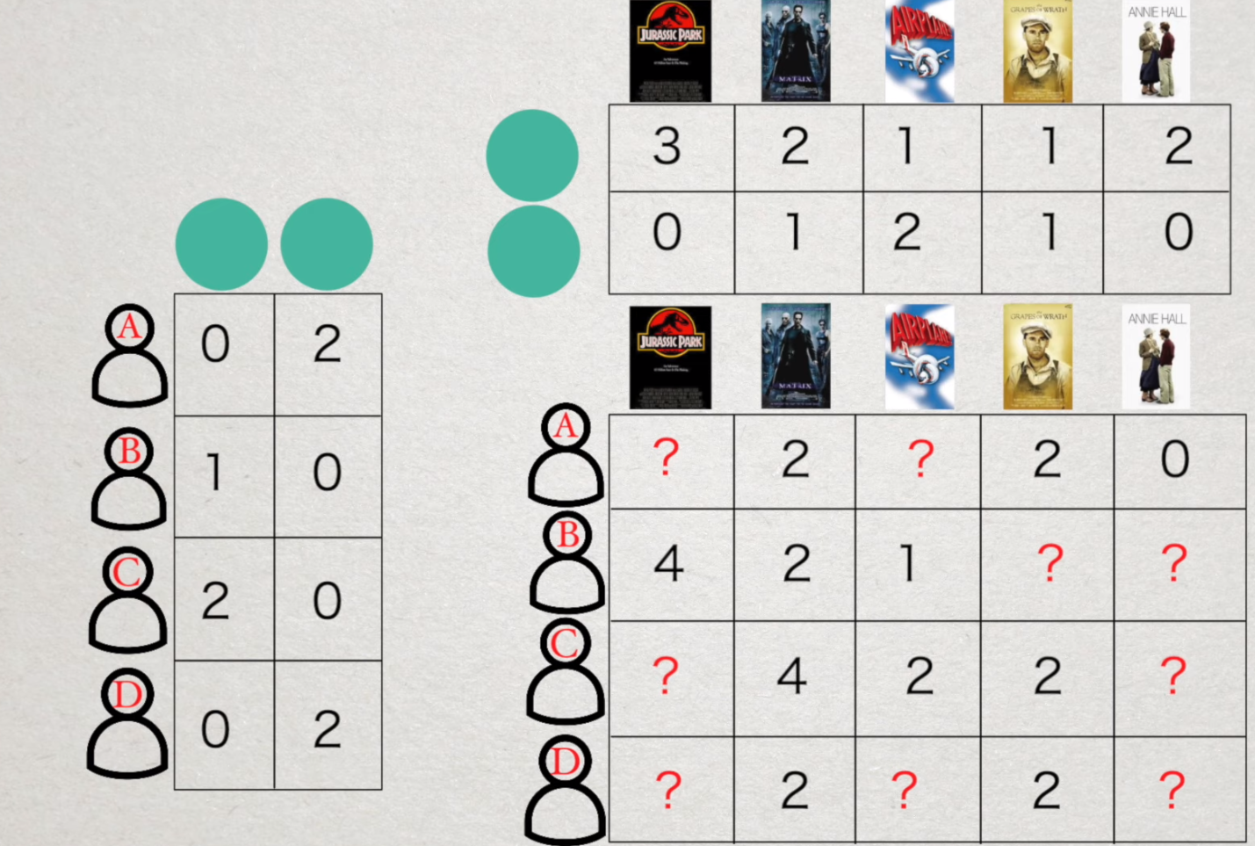
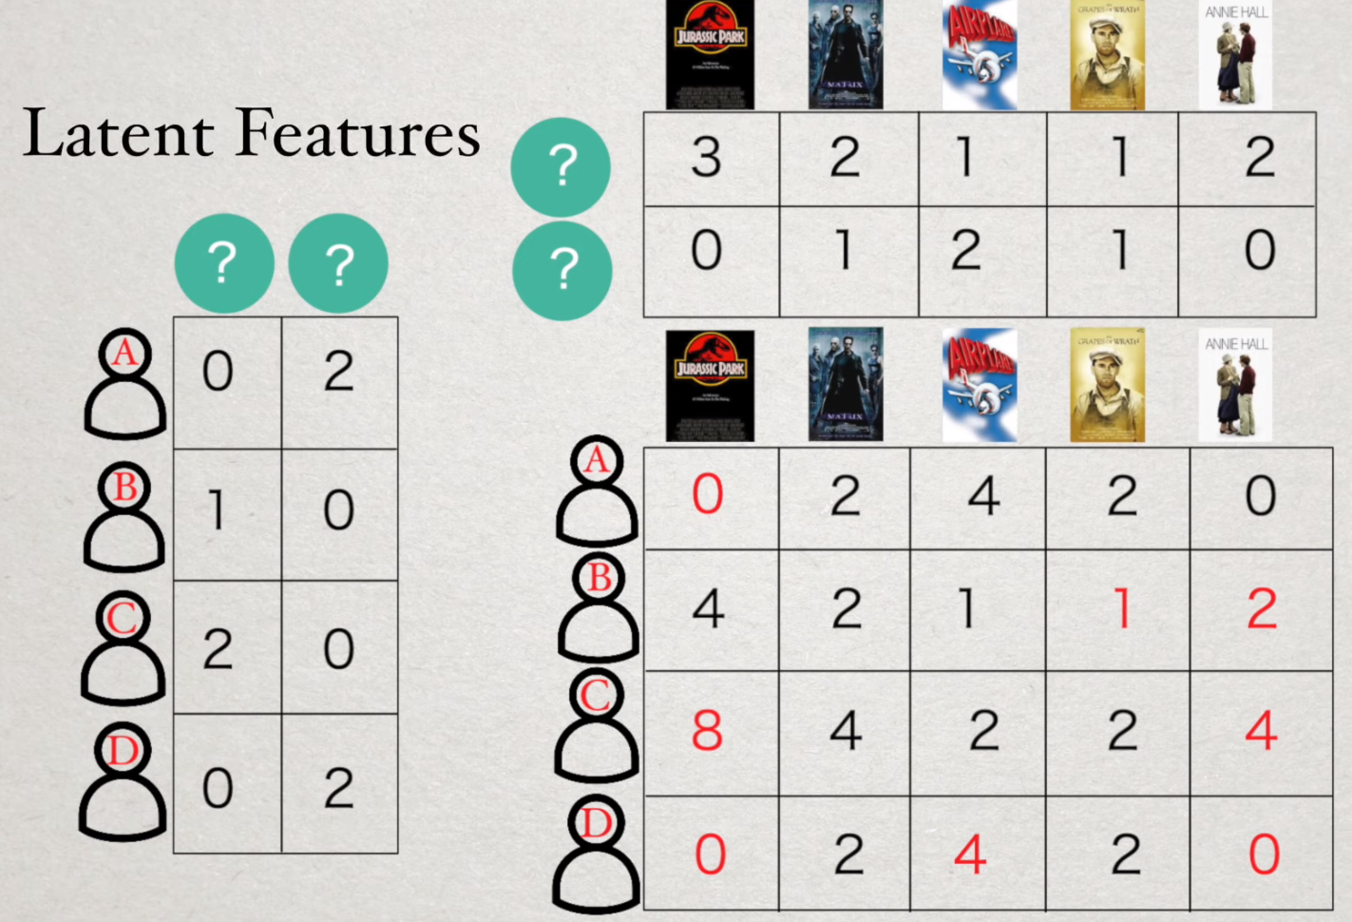
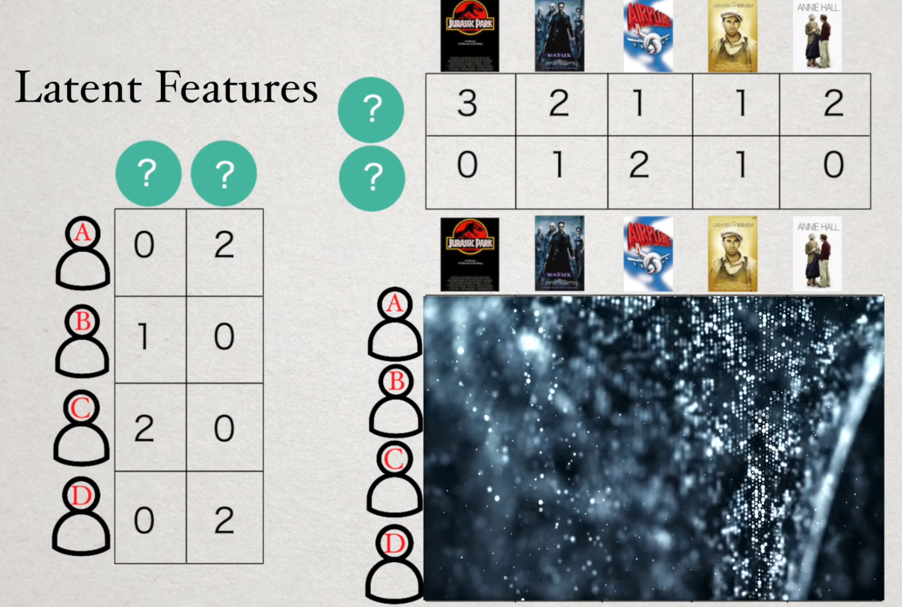

Collaborative-based filtering
Logic
1
2
3
Reference: How Recommender Systems Work (Netflix/Amazon). https://www.youtube.com/watch?v=n3RKsY2H-NE
Notes:
To be noted that

Slide 6
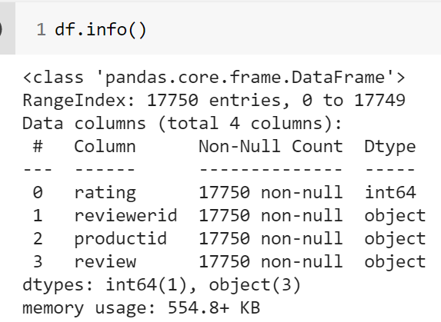
Basic recommender system (userID & productID & Rating)

Slide 7
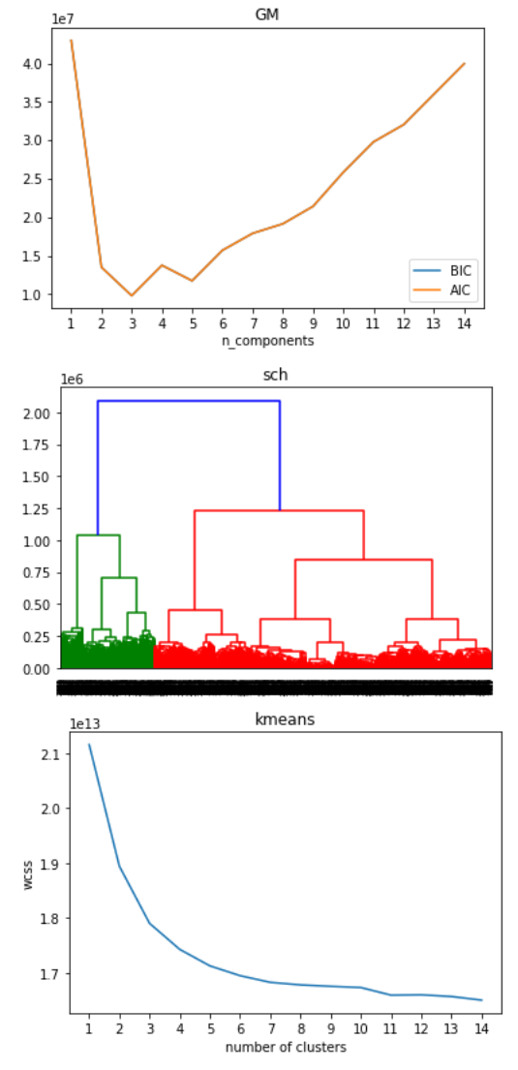
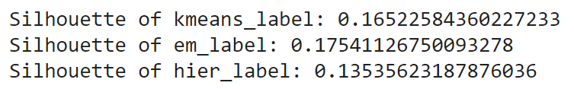
Improve(+clustering review-Bert)
Combine comments from the same userid (2749 userid)
find out the best number of clustering for each algorithm
Calculate silhouette with each algo under its best number of clustering
Clustering users based on their reviews via the champion algo(GaussianMixture)

Slide 8
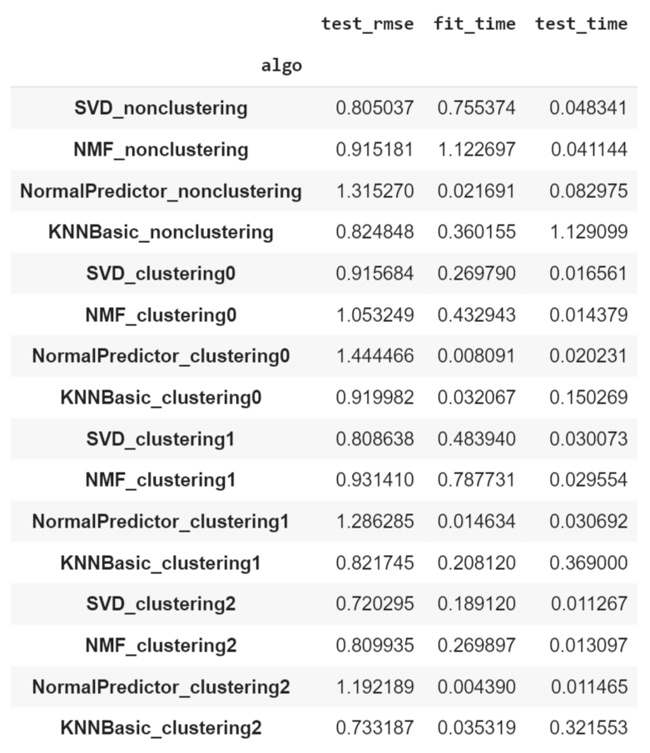
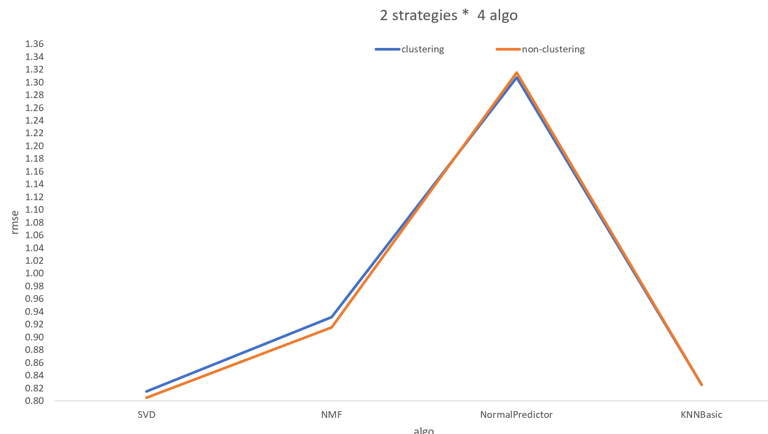
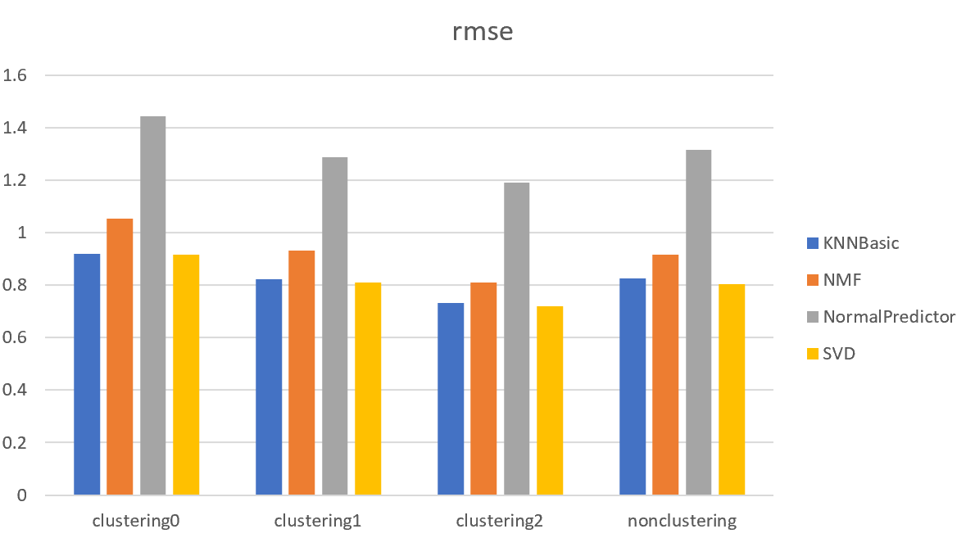
Basic system VS improved one
Best algo for each clustering would be recorded for later prediction

Slide 9
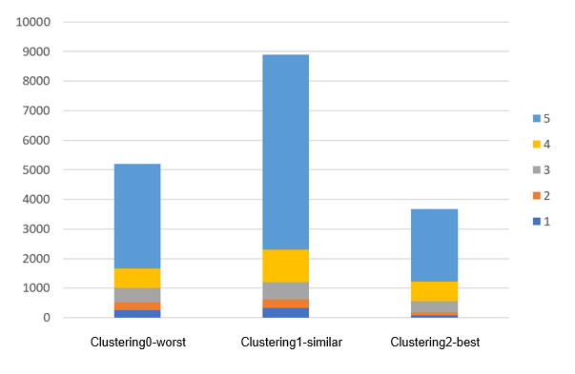
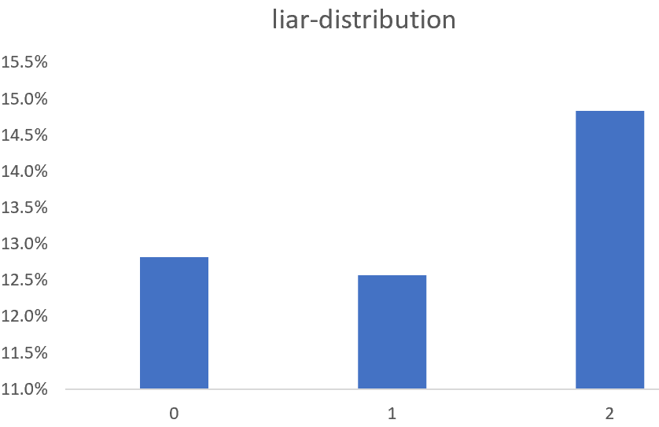
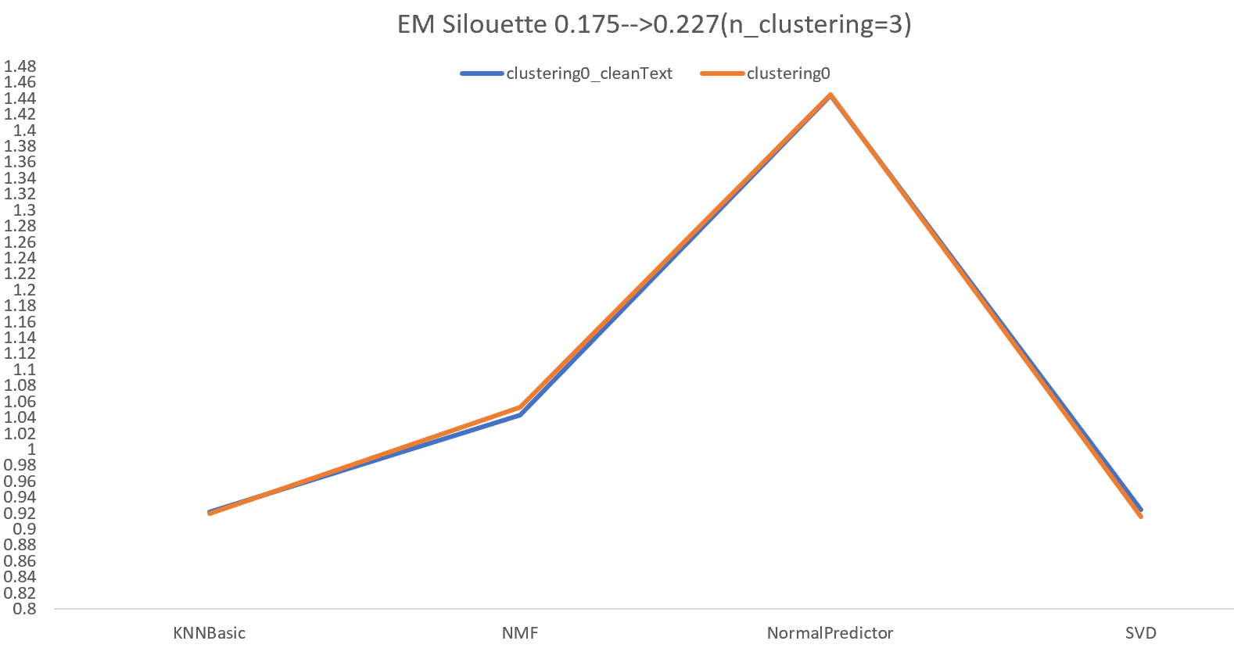
Analysis
Hypothesis | Verification | Result | Conclusion
Sentiment | Sentiment distribution |  | No relation
Liar | Distribution of liar |  | No relation
Low clustering performance(silhouette) | Cleaned text, increased silhouette |  | A bit related
Right direction !

Slide 10
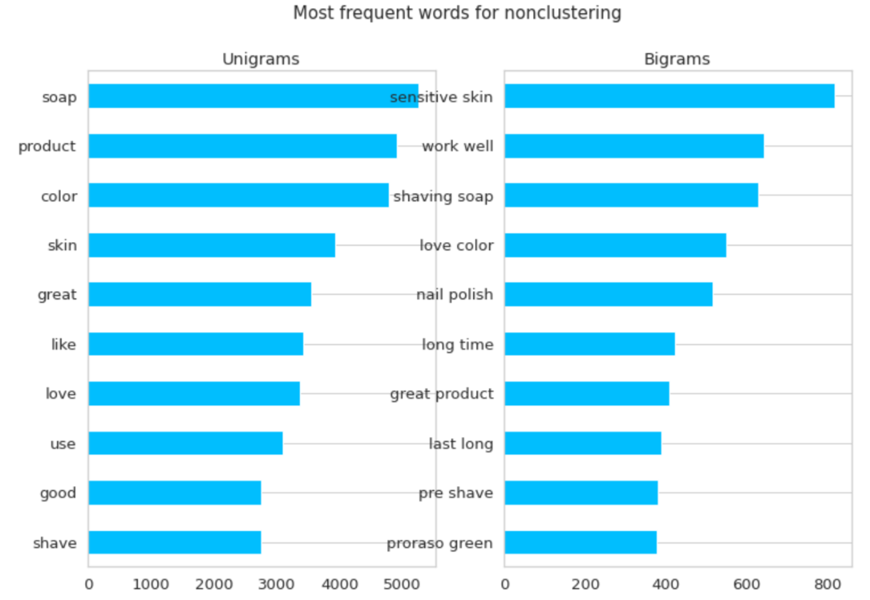
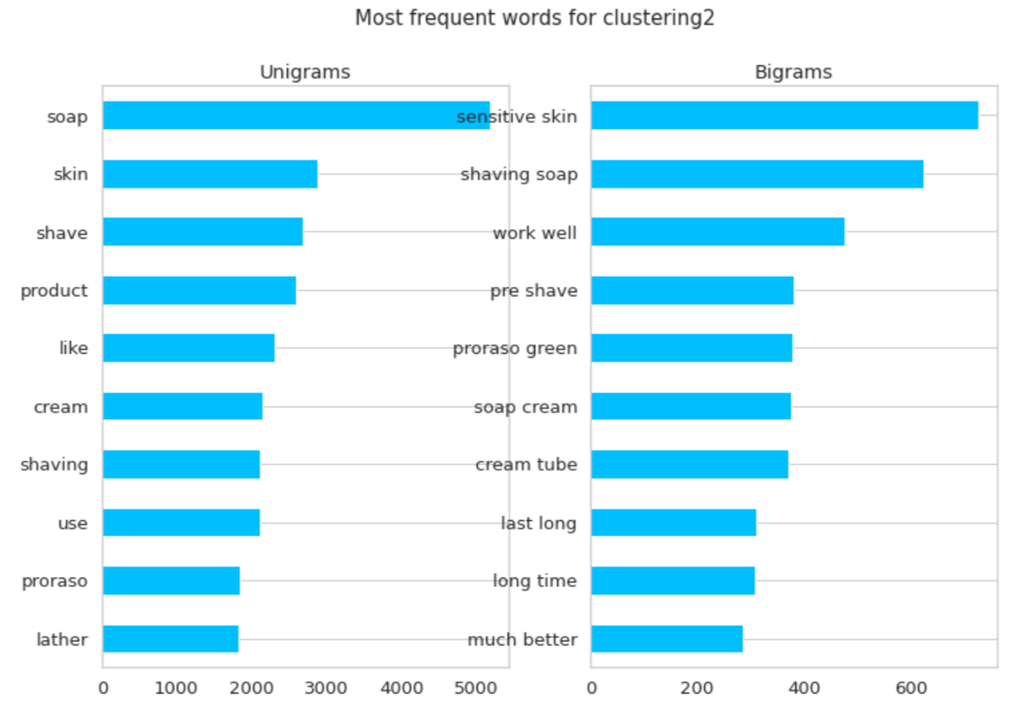
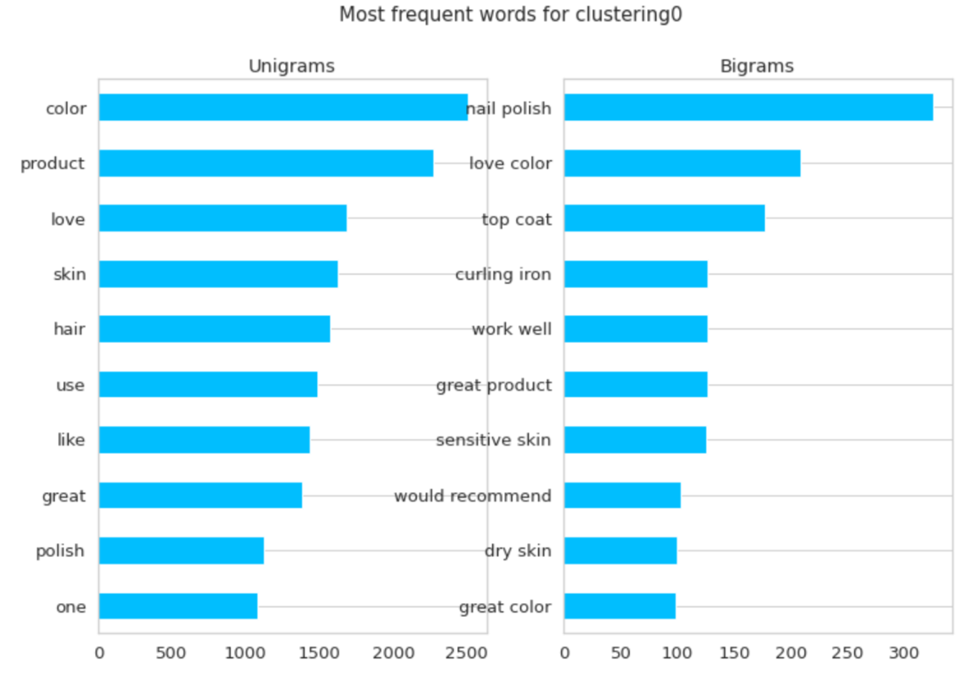
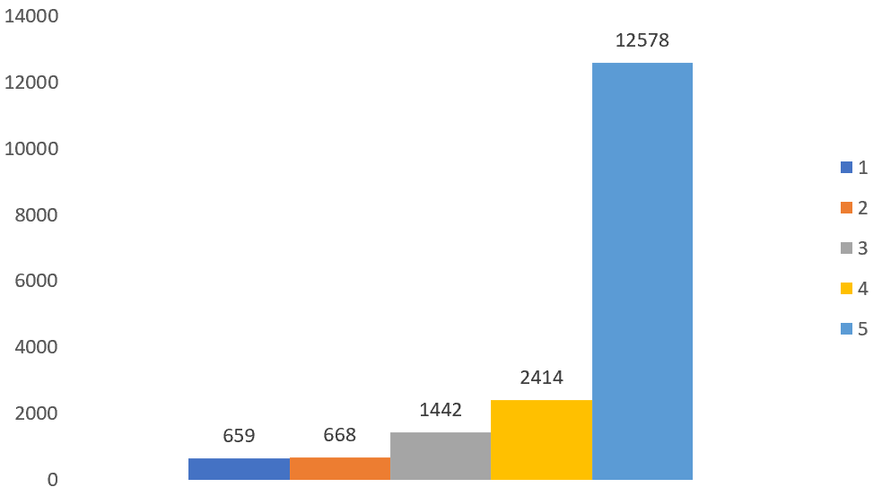
Text Analysis
Indistinct review???
6/10=60% (nonclustering & clustering2)
7/10=70% (nonclustering & clustering0)
Kind words are similar

Slide 11
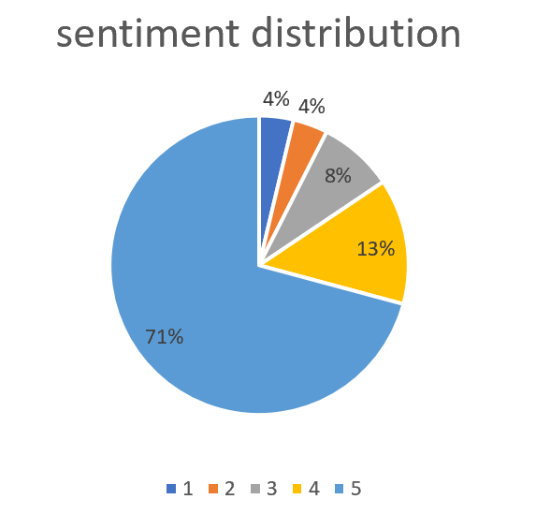
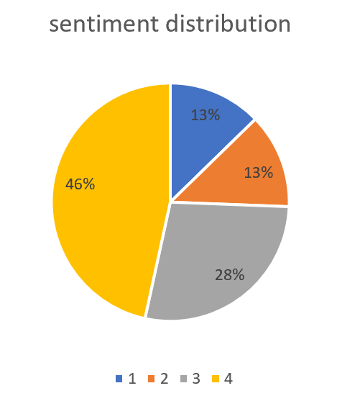
Increased Silhouette
Excluded 5 star rating
EM Silhouette: 0.401 (big increase）

Slide 12
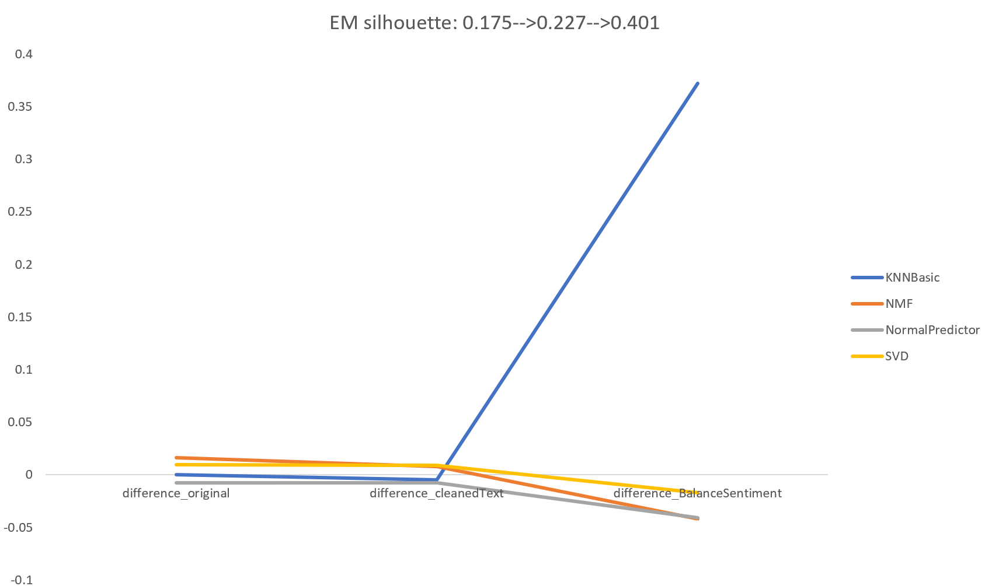
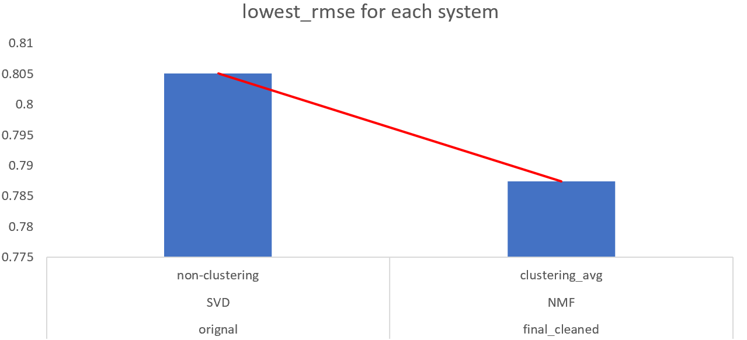
Recommendation
Performance for each clustering under different algo
Lowest RMSE for clustering and non clustering
For each clustering, system could automatically choose that best algo with lowest rmse to create prediction
Contact prediction from clustering0,clustering1 into strategy1(clustering) and nonclustering as strategy0(nonclustering)
Best recommendation is from strategy1: clustering users firstly, then make recommendation.

Slide 13
Thank you!
13

